Slide 1
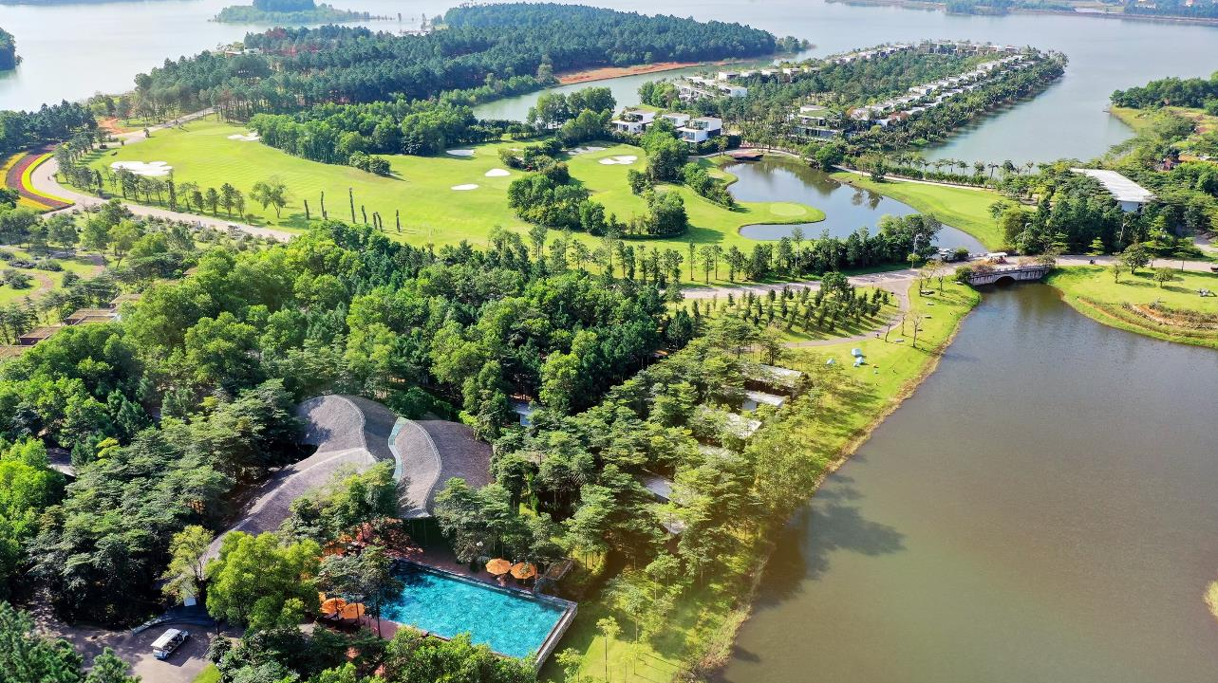

TOP 10 HOTELS & RESORTS WOLRDWIDE

Slide 2

Table of content
Overview
Accommodation
Cuisine
Meetings & Events
Wellness
Entertainment
Sports
Attractions

Slide 3
1
OVERVIEW

Slide 4
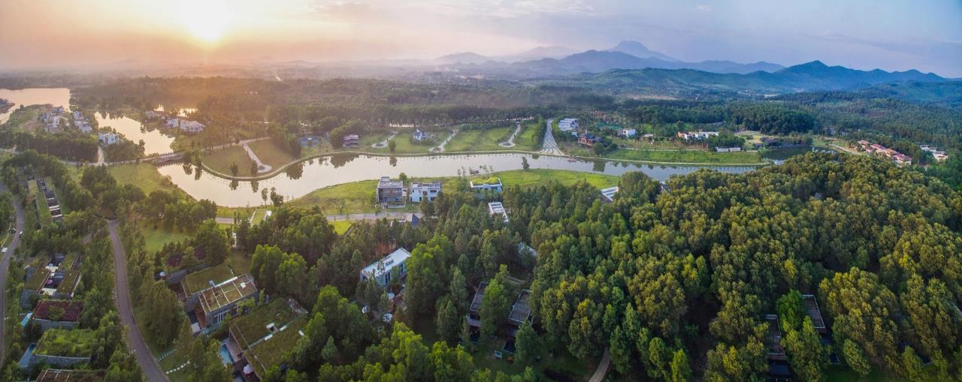
Flamingo Dai Lai Resort is located in an area surrounded by spectacular mountains and delta in Ngoc Thanh, Phuc Yen, Vinh Phuc Province
Situated in the North of the romantic Dai Lai Lake with a total area of more than 1.23 million sqm, the resort includes Peninsulas, islands, forest, lake and 3km long lakeshore

Slide 5
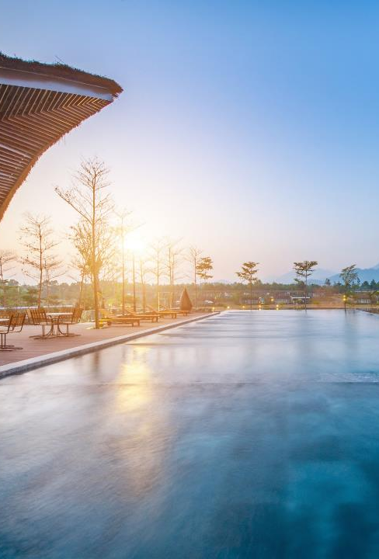
STRATEGIC DESTINATION
The only 5-star Resort in Hanoi
Conveniently located close to the airport:
  Only a 20-minute drive (20 km) from Noi Bai International Airport
Maximum support for transportation
  Transportation arrangements with financial support for tours to nearby destinations
  Complimentary roundtrip shuttle bus: Dai Lai – Hanoi – Dai Lai
  Dedicated airport transportation services upon request
Ease of access with brand-new highways
  Well-connected for a variety of itineraries
Flexibility to work with any schedule:
  Special day-use packages to accommodate early departures and late arrivals

Slide 6
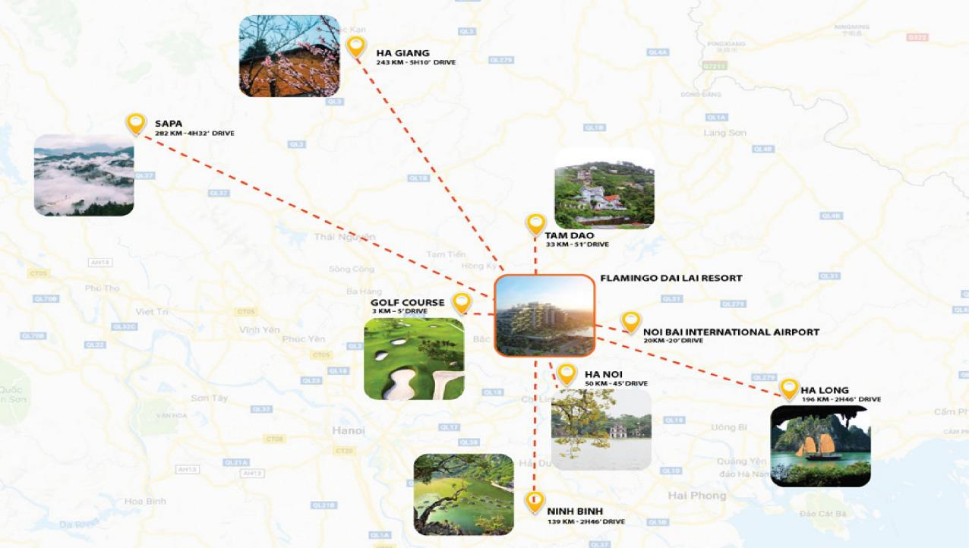

Slide 7
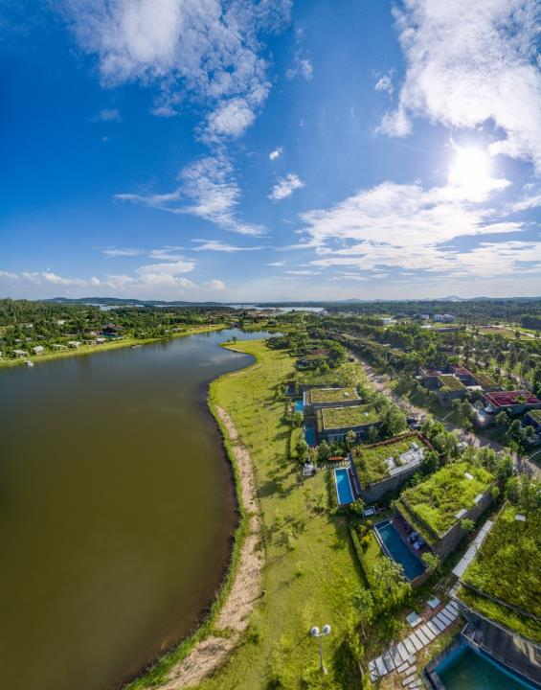
65 PRESTIGIOUS INTERNATIONAL AWARDS
Luxury Family Resort (Global Winner)
World Luxury Hotel Awards
Top 10 hotels & resorts worldwide
Designboom Magazine
Wedding Destination with best value for money
Hitchbird Wedding Awards
And more than 62 other prestigious awards.

Slide 8
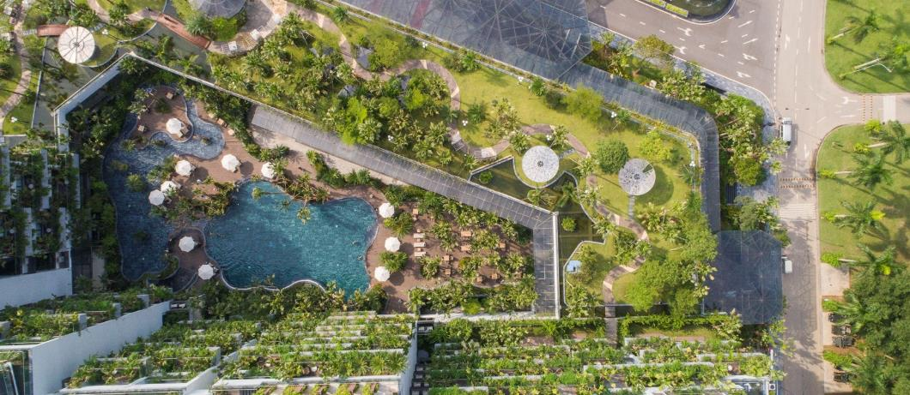
National Records
Flamingo Dai Lai Resort – The Resort with the most architecture awards in Vietnam
Wyndham Grand Flamingo Đại Lải Resort – The landmark with the highest number of hanging gardens in Vietnam
Wyndham Grand Flamingo Đại Lải Resort– The landmark with the largest, most unique hanging gardens in Vietnam
SEVA Spa & Beauty Destination – The largest beauty & wellness Spa in Vietnam
Art in the Forest – The largest lakeside art space in Vietnam

Slide 9
2
ACCOMMODATIONS

Slide 10
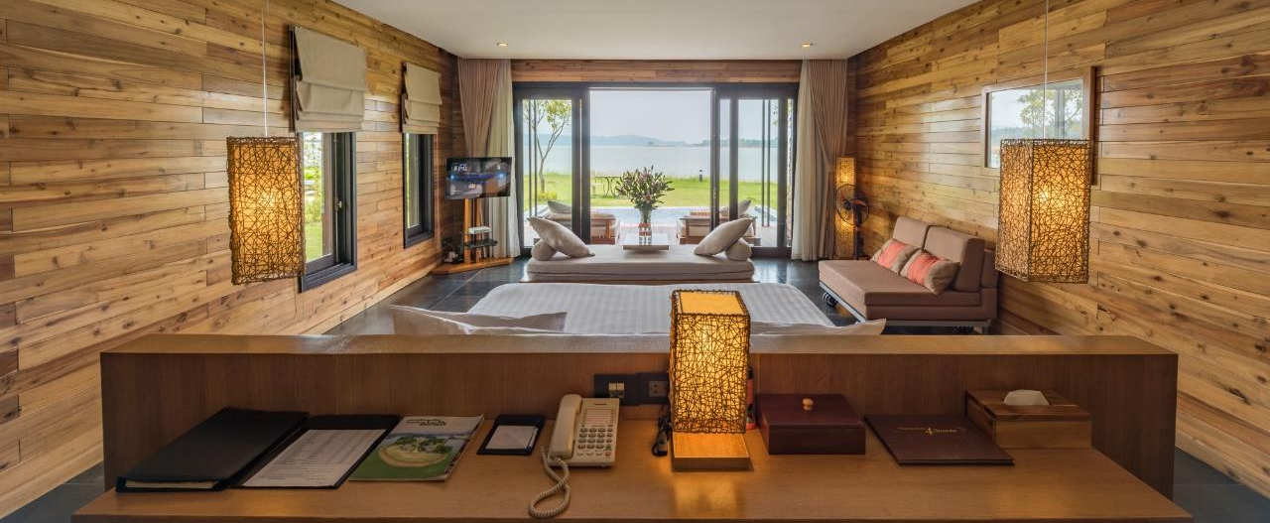
Flamingo Dai Lai Resort
Villa Collection

Slide 11
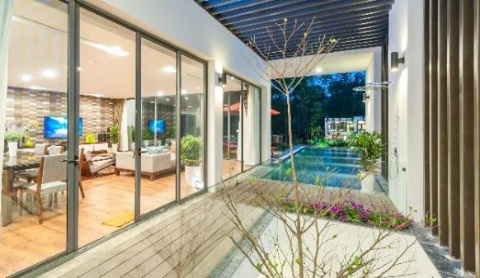
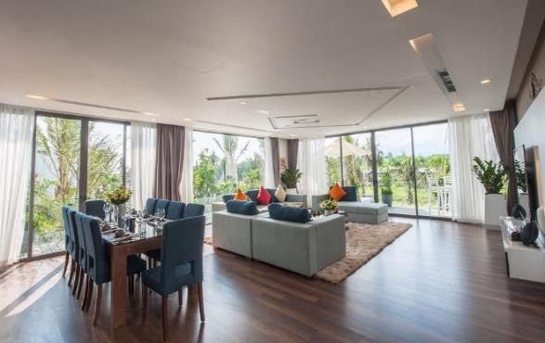
Dịch vụ
Collection of 200 luxurious and elegant villas surrounding Dai Lai Lake
Nearly 300 room keys with contemporary design and elegant terraces
A variety of options: from standard to luxury villa, from 1 to 4 bedroom villas, with or without private swimming pool
Forest Villa - 01 Bedroom
Hilltop Villa - 01 Bedroom
Hilltop Executive Villa – 02 Bedroom
Charm Villa - 02-03 Bedroom
Luxury Skylake Villa - 04 Bedroom
Hoang Oanh Villa - 03 Bedroom
Bach Thanh Villa - 02-03 Bedroom
Do Quyen Villa - 02-03 Bedrooms
Anh Vu Villa - 02-03 Bedroom
Thien Tuoc Villa - 02-03 Bedroom
Hoang Anh Villa – 02 Bedroom

Slide 12
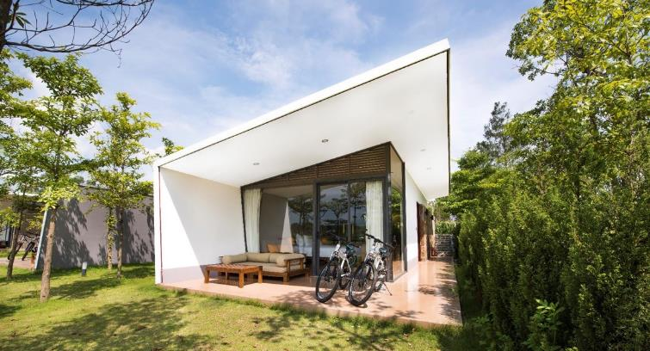
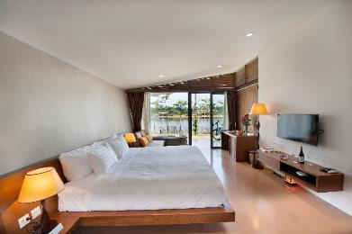
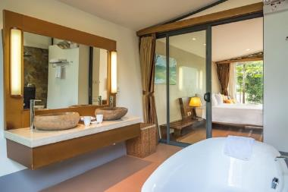
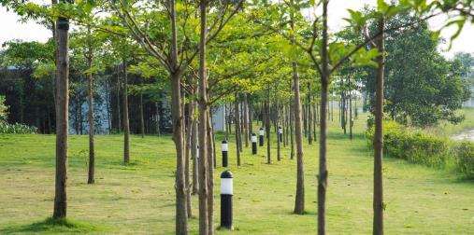
Forest Resort
31 Forest Villas with one (01) bedroom
Square: 72 sqm
Restaurant & outdoor bar
North Vietnam’s largest outdoor heated pool

Slide 13
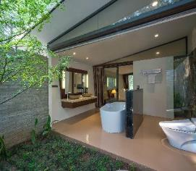
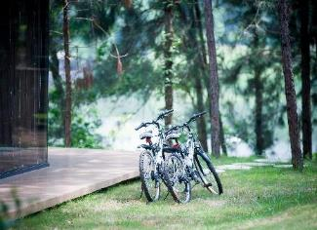
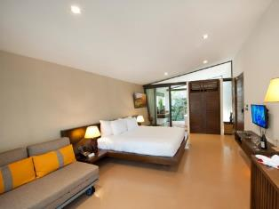
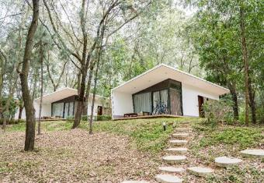
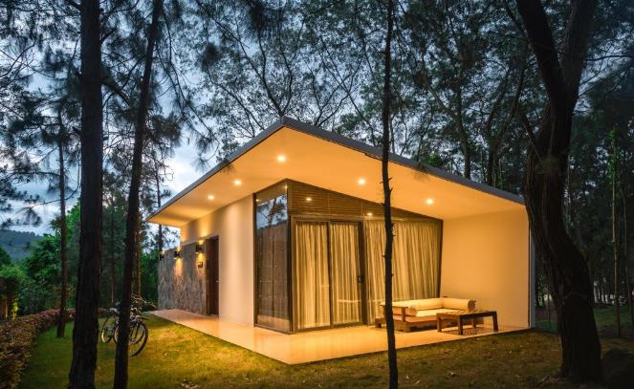
Hilltop Villa
16 one-bedroom Hilltop Villa
Square: 72 sqm
Luxurious outdoor bar
World-class facilities

Slide 14
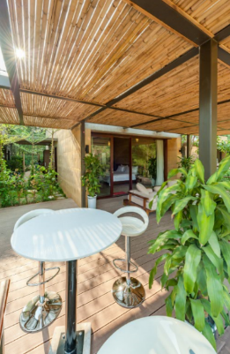
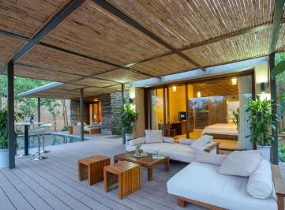
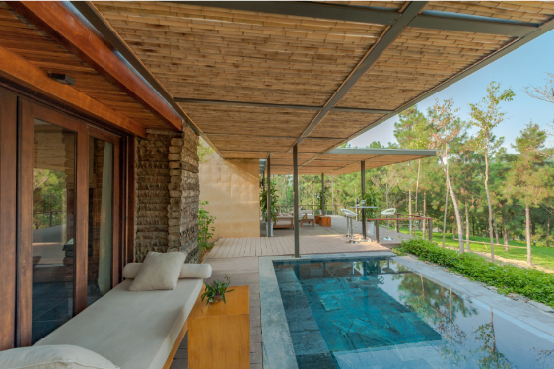
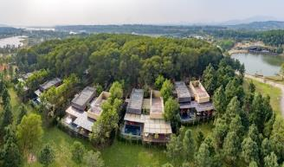
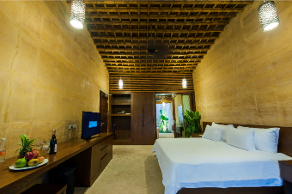
Hilltop Executive Villa
2 one-bedroom Hilltop Executive Villa
Square: 433 sqm
Private swimming pool

Slide 15
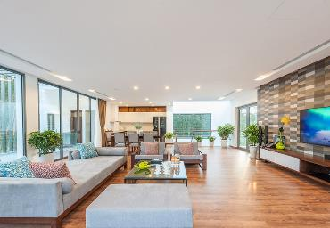
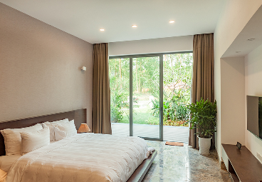
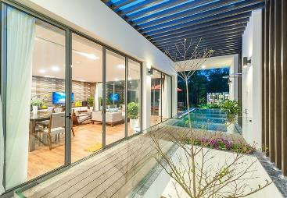
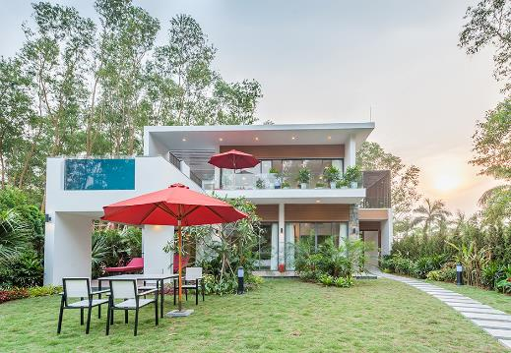
Charm Villa 1, 2 & 3
• 31 villas with 2 storyes and from 2 to 3 bedrooms
• Square: 234 - 352 sqm
• Elegant living room
• Modern kitchenette and dining
• Front and backyard
• Private outdoor pool

Slide 16
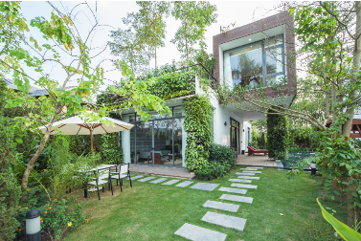
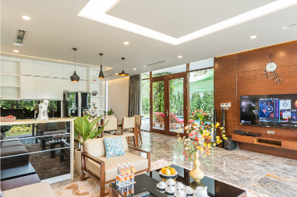
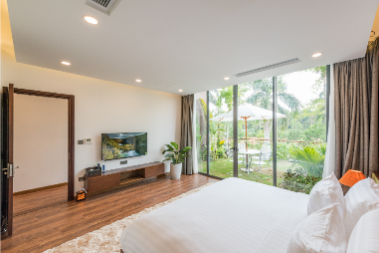
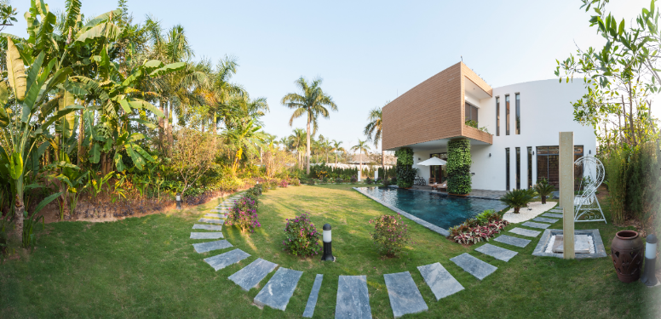
Hoàng Oanh Villa
28 villas with 3 bedrooms
Square: 325 - 377 sqm
Elegant living room
Modern kitchenette and dining
Garden & upstairs terrace
Large bathtub and private outdoor pool

Slide 17
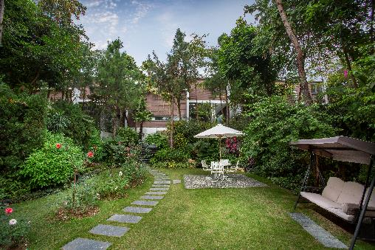
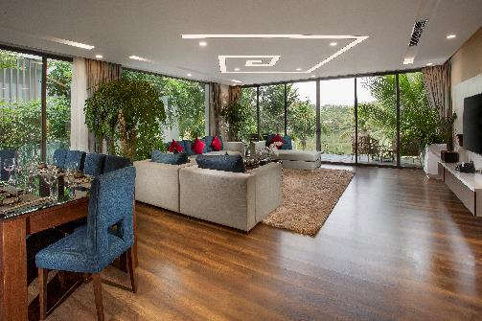
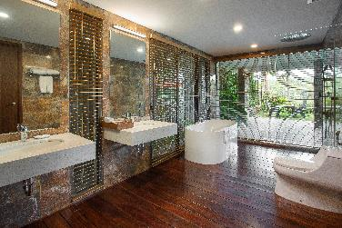
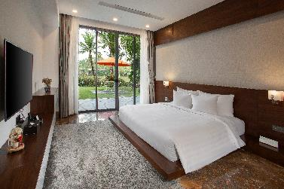
Luxury Skylake Villa
20 four-bedroom villas
Square: 350 - 665 sqm
Sizeable surrounding yard with hanging garders
Outdoor bar and elevated pool
Grand living room, kitchen and dining room
Private study, entertainment room and kids’ playground
Unique art collection

Slide 18
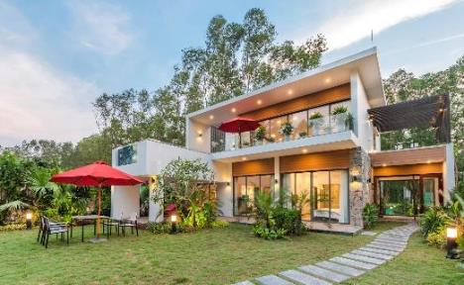
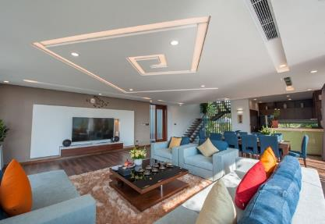
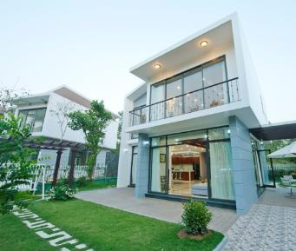
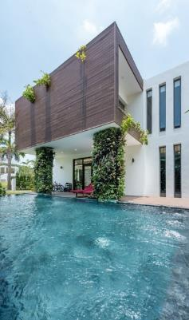
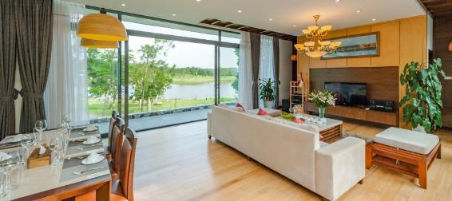
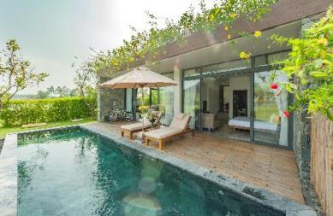
Charm Villa
Luxury Skylake Villa
Anh Vu Villa
Do Quyen Villa
Bach Thanh Villa
Flamingo Villa
Villas from 2 to bedrooms
Private swimming pool
Spacious garden
Living room, kitchenette, dining room
Private bar
Bathtub and sauna
Hoang Oanh Villa

Slide 19
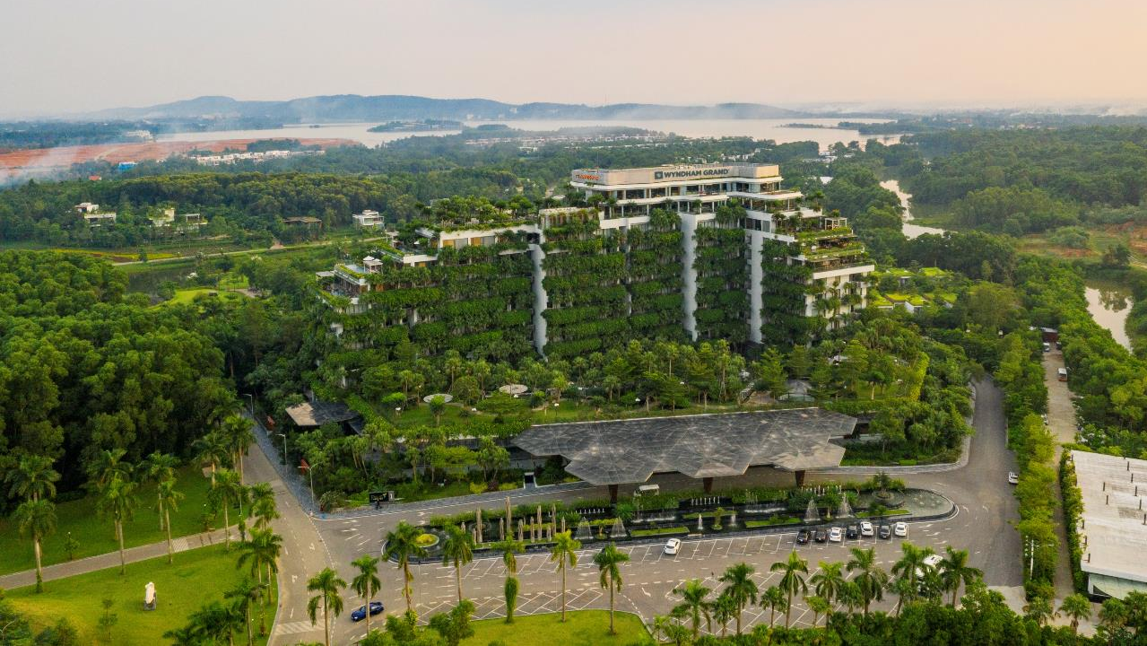
WYNDHAM GRAND FLAMINGO DAI LAI
Featuring a brand-new concept of sky villa with each unit having its own “hanging garden” and a panoramic view over the Dai Lai Lake and mountains

Slide 20
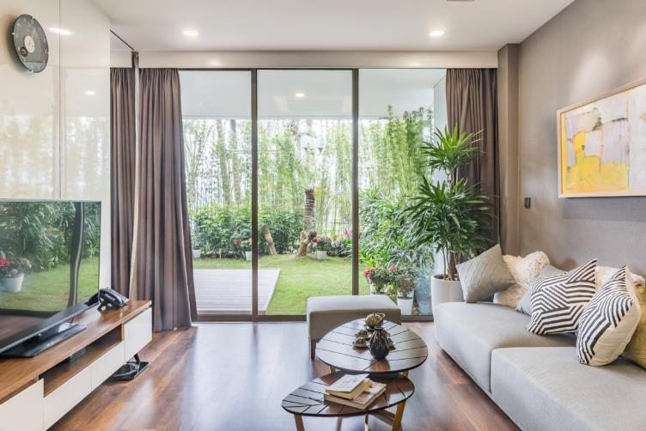
Wyndham Grand Dai Lai Resort
181 Sky Villas totaling 250 room keys, ranging from 1- to 3-bedroom apartments
From level 2 to 9 of Wyndham Grand Dai Lai Resort
Open space designed to take full advantage of natural lighting & atmosphere
Indoor art-space showcasing authentic signed artworks from esteemed artists

Slide 21
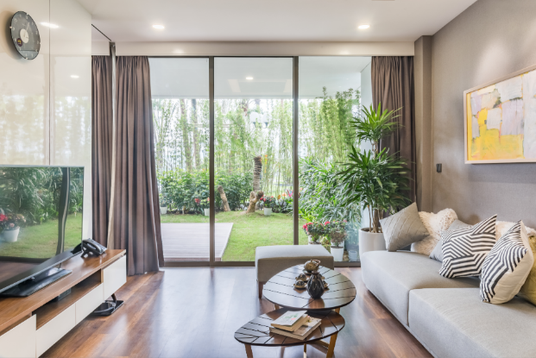
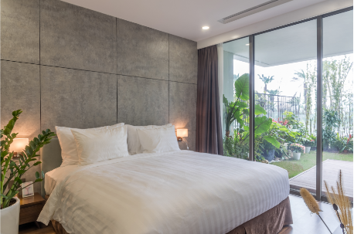
Category | Area (sqm) | No
01 Deluxe Sky Residence | 60 | 34
01 Premier Sky Residence | 66 - 82 | 54
01 Executive Sky Residence | 75 - 98 | 36
02 Deluxe Sky Residence | 91 - 103 | 13
02 Premier Sky Residence | 103 - 143 | 22
02 Executive Sky Residence | 98 - 144 | 10
03 Premier Sky Residence | 134 | 2
03 Executive Sky Residence | 186 - 248 | 3
President Sky Suite | 354 - 395 | 2
Royal Sky Suite | 432 - 597 | 4
Imperial Sky Suite | 883 | 1

Slide 22
3
CUISINE
The complex of 6 restaurants & 6 bars with a capacity of 50 to 600 guests

Slide 23
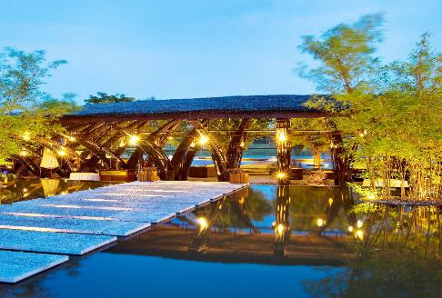
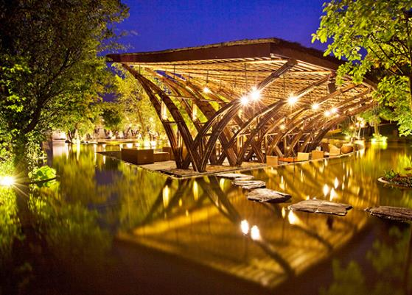
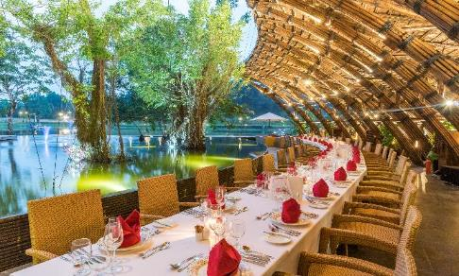
Bamboo Wings Restaurant
Capacity: 140 guests
The pride of Vietnamese architecture with multiple international awards - Bamboo Wings Restaurant offers distinctive Asian cuisine in a harmonious setting of wind, water, greenery and art hills.

Slide 24
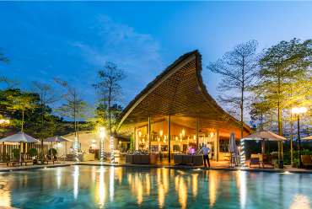
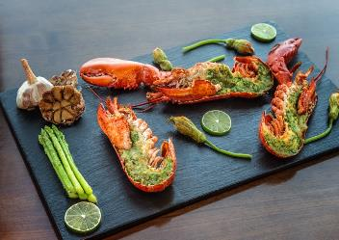

Forest Restaurant
Capacity : 200 guests
With a panoramic view over Bach Thanh lake, Forest Restaurant offers a culinary experience infused with and inspired by fresh, luscious nature
The Beach
Capacity: 600 guests
Located at the edge of the forest with vast stretches of grassland, this waterfront restaurant offers diners an invigorating open space with fresh air and hearty cuisine.

Slide 25


Poem Restaurant
Capacity : 320 guests
Charm Palace Restaurant
Capacity : 180 guests
A crystal-clear gem among lush foliage, Poem Restaurant is flooded with natural light, creating a nature-infused culinary experience with buffet and À la carte menu.
Nestled inside a lush forest, the hilltop Charm Palace is a secluded venue reserved for event bookings and your every special occasion.

Slide 26



Sky Bar & Restaurant
Capacity: 200 khách
Location: Level 10 & 11, Wyndham Grand Flamingo Dai Lai Resort
A romantic stroke on the canvas of the sky – Sky Bar & Restaurant features an indoor dining area with infinity glass walls and an outdoor garden sky bar. With open space, natural lighting and a breathtaking panoramic view, this is the place to be for a culinary experience of cloud-nine relaxation.

Slide 27

Palm Pool Bar
Capcity: 150 guests
Location: Palm Pool & Lobby
Wyndham Grand Flamingo Dai Lai Resort
The perfect combination of indoor & outdoor space, this enchanting tropical is where you can enjoy freshly made drinks for a signature resort paradise experience.

Slide 28


Piano Bar
Location: 100 guests
Location: Level 1 - Wyndham Grand Flamingo Dai Lai Resort
A luxurious yet cozy lobby bar where you can stop by any time of day.
Forest Bar
Sức chứa: 100 khách
Vị trí: Khu Forest
Wyndham Grand Flamingo Dai Lai Resort
Với tầm nhìn hồ Bách Thanh và bể bơi Forest khoáng đạt, Forest Bar thích hợp với những bữa tiệc bên hồ nhẹ nhàng và ấm cúng của gia đình và hội nhóm.

Slide 29


Poem Bar
Capacity: 200 guests
Location: Poem complex
Container Bar
Capacity: 70 khách
Location: Flamingo Contemporary Art Museum
Inspired by the old colourful container in the middle of the pine forest, Container Bar offers visitors a unique space to enjoy drinks and relish art.
With its signature winged bamboo architecture resembling a bird taking flight, the Poem pool bar offers a tranquil, laid-back atmosphere for when you would like to sit back, relax and enjoy a glass of cocktail.

Slide 30


The Beach Bar
Capacity : 40 guests
Location : The Beach area
Situated by the shore, The Beach bar offers the most romantic panoramic view with fresh open-space architecture and elegant furniture, creating a cozy atmosphere for an enjoyable getaway.
Bamboo Wings Wine Cellar
Capacity: 20 guests
Location: Bamboo Wings restaurant
Nestled in the heart of green grassy hill, the Bamboo Wings wine cellar – bar is the pinnacle of luxury with opulent interior design, secluded space and a treasured collection of fine wine

Slide 31
4
MEETINGS & EVENTS

Slide 32

Dịch vụ
Meetings, Conferences and Events
Only a 45-minute drive from Hanoi, with a harmonious blend of nature and architecture, Flamingo Dai Lai Resort is the perfect choice for conferences, meetings, and ceremonies.
• Classic room – capacity: 30 guests
• Charm Palace restaurant – capacity: 200 guests
Opera Hall – capacity: 250 guests
• The Symphony Hall – capacity: 600 guests
Spacious outdoor venues for team-buildings

Slide 33


Symphony Hall
Capacity: 600 guests
Directly accessible from Wyndham Grand Flamingo Dai Lai Resort reception hall
The perfect venue for special occasions, parties, gala dinners, seminars, meetings and conventions.

Slide 34


Opera Hall
Capacity: 300 guests
With its distinctive bamboo roof architecture, the Opera Hall adds a quintessential touch of Vietnam to every meeting and conference

Slide 35


Opera House
Capacity: 280 guests
With a professional atmosphere and contemporary design, Opera House is perfectly suited for a variety of events, meetings and conventions.

Slide 36



Charm Palace Restaurant
Capacity: 180 guests
Nestled inside a lush forest, the hilltop Charm Palace is a secluded venue reserved for event bookings and your every special occasion.

Slide 37


Biz Space
Capacity: 20 guests
Location: Wyndham Grand Flamingo Dai Lai Resort
Bright and airy with vibrant design, Biz Space is sure to enhance the energy and creative flow of your meetings and events.

Slide 38

Outdoor event venue
Location: 1900 guests
Location: Dai Lai lakeside
Spanning across a vast grass-covered lakeside area surrounded by pinewoods, this sizeable outdoor venue is the ideal choice for events and teambuilding programs near Hanoi.

Slide 39




Wedding venues & services
Wedding destination with best value for money
Blessed with a distinctly romantic setting where mountains meet waters, Flamingo Dai Lai Resort is the destination for your love to bloom.
25 wedding venues: villa gardens, coast side, pine forest, etc.
Exquisite wedding cuisines
Impressive sound & stage design
Fresh floral décor
Newlyweds & honeymoon suites
Wedding photography services

Slide 40
5
SEVA SPA & BEAUTY DESTINATION

Slide 41


Slide 42


SEVA Spa & Beauty Destination
Vietnam’s largest beauty & wellness Spa with 5 functional areas and nearly 50 distinctive treatment rooms spanning a total area of more than 5000 sqm. Boasting state-of-the-art technology and equipment, SEVA Spa & Beauty Destination provides exceptional care and treatment with the consultation of leading experts from Dubai and France.

Slide 43



SEVA Spa
Journey with us through 3 main areas of SEVA Spa for a wellrounded rejuvenating experience:
Jacuzzi zone – with sauna & steam, hot/warm/cold jacuzzi, tropical rain and Japanese seated showers
Korean Jjimjilbang zone – with a signature Relaxation Lounge, special foot soaks and an array of nature-infused saunas
Massage & treatment area – with Vichy showers, foot massage, single/group/VIP massage suites, offering de-stress & relaxation massage therapies with 100% natural ingredients and essential oils.

Slide 44


JJIJMJILBANG
Koreans’ Secret to Long-lasting Health and Beauty
Quartz Sauna for deep detoxification, pain relief, and increased brain power
Mud & Herbs Sauna for skin rejuvenation and improved respiration
Ion & Colors Sauna for overall balance and stabilized mind
Himalayan Crystal Salt Sauna for deep relaxation and osteoporosis prevention
Volcanic Rocks Sauna for improved circulation and energy replenishment
Snow Sauna for skin tightening and increased mental acuity
Oxy - Hinoky Sauna for mind refreshment and skin rejuvenation
Infrared Caves for weight loss, detoxification and cell regeneration
Heated Foot Soak for arthritis treatment and sleep improvement
Cold Foot Soak for improved physical strength and blood circulation
Relaxation Lounge with underfloor heating for increased circulation and energy amplification

Slide 45

SEVA Beauty
Location: Level 1A - Wyndham Grand Flaming Dai Lai Resort
Beautification services ranging from hairstyling, manicure-pedicure to skin treatments with the latest technologies including LPG and Neogen Nitro-Plasma

Slide 46

Leisure Lounge
Location: Level 1A - Wyndham Grand Flamingo Dai Lai Resort
In addition to treatment areas, SEVA also includes a special light and airy Leisure Lounge with a tranquil and therapeutic atmosphere for when you would like a moment to sit back, relax and unwind during your time at SEVA.

Slide 47



Bể bơi Forest
Bể bơi Palm Pool
Bể bơi Poem
Pools & Sauna
An array of tropical oasis & water wonderlands nestled under the shade of palm trees for moments of relaxation

Slide 48




Fitness Centre
Masterfully designed to create a spacious and airy work-out environment, the Fitness Centre comes equipped with the latest first-rate gym facilities and amenities for the best fitness experience.

Slide 49
6
ENTERTAINMENT

Slide 50



Flamingo Play World Entertainment complex
VR Game Park
Legacy Game Centre
Cinema
Karaoke
Flamingo Kids Club
Wonder Park

Slide 51


Phoenix Zone
Phoenix Zone – a Real role-playing game for those who want to experience physical activities and spirit in a unique way!

Slide 52




VR Game Park
Location: Level B - Wyndham Grand Flamingo Dai Lai Resort
South-east Asia’s largest, leading-edge VR game park with over 1000 game titles for a truly immersive entertainment experience

Slide 53



Flamingo Play World
Location: Level B
Wyndham Grand Flamingo Dai Lai Resort
The fun never stops at this classic amusement game centre filled with exciting coin-op arcade games – perfect for family bonding moments.

Slide 54


Rạp chiếu phim
Location: Level 1 - Wyndham Grand Flamingo Dai Lai Resort
An in-house cinema where free movie screenings are held for all in-house guests. With a capacity of 40 people, the venue is also suited for medium-scale meetings and events.
Karaoke
Location: Wyndham Grand Flamingo Dai Lai Resort & Bamboo Wings Restaurant
A total of 4 first-class Karaoke rooms with state-of-the-art AV systems and KTV equipment. With a capacity of 20 people each, these Karaoke rooms create the perfect musical atmosphere for private parties.

Slide 55



Flamingo Kids Club
Location: Level 1, Wyndham Grand Flamingo Dai Lai Resort
A childhood wonderland bubbling in the heart of Forest in the Sky for your little angels. Exciting games and activities for a holistic personal development of body, mind and soul await. Complimentary on-site babysitting service is available.

Slide 56






Wonder Park
Nestled in the heart of a pine forest, Wonder Park is specifically designed with winding grassy hills and a variety entertainment activities and creative outdoor games.
Wonder Park
Wonder Park

Slide 57
7
SPORTS

Slide 58




Sports Club
Tennis
Sports bike
Twin bicycle
Billiards
Foosball
Volleyball
Basketball

Slide 59




CLB Bãi biển
Kayak
Water pedals
Water walking balls
Lifebouys & life vests
Wooden boat
Canoe
Banana boat
Yatch

Slide 60
8
ATTRACTIONS

Slide 61




Art in the Forest
Throughout the resort, along scenic roads and in windy pinewoods, hundreds of artworks and sculptures lie on display as part of our international Art in the Forest exhibition – a signature attraction of the Flamingo land of art.

Slide 62


Sky Park
Wyndham Grand Flamingo Dai Lai Resort’s beauty spot with a gorgeous sky walk through verdant tropical greeneries, fresh-water Koi ponds & hundreds of mini-hanging gardens.

Slide 63





Nearby Attractions
Flamingo Dai Lai Resort lies in the centre of the tourist area of Vinh Phuc Province, Vietnam - boasting diverse cultural attractions, scenic mountains and rivers, and a variety of famous beauty spots.
Thiền viện Trúc Lâm Tây Thiên
Làng gốm Hương Canh
Khu du lịch Tam Đảo
Làng hoa Mễ Linh
Tháp Bình Sơn

Slide 64

Address: Ngoc Thanh, Phuc Yen, Vinh Phuc
Hotline: (+84) 98 600 9393 | T: (+84)211 626 8679
F: 0211 626 8679
Email: sales@flamingogroup.vn
Website: flamingoresorts.vn
Hanoi Office: Floor 4,6 - Vinafor Building, 127 Lo Duc, Hai Ba Trung, Hanoi
T: (024) 7304 6669| F: (024) 3928 6388

